Slide 1

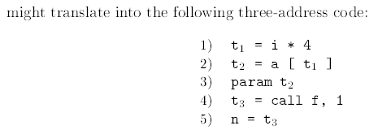
Intermediate code for procedures
Assume that the parameters are passed by value.
Suppose that a is an array of integers, and that f is a function from integers to integers. Then, the assignment

Slide 2
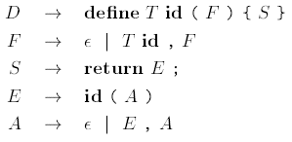
Intermediate code for procedures
Symbol tables:
Let s be the top symbol table when the function definition is reached. The function name is entered into s for use in the rest of the program.
In the production for D, after seeing define and the function name, we push s and set up a new symbol table
Env.push(top); top = new Env(top);
Call the new symbol table, t. Note that top is passed as a parameter in new Env(top), so the new symbol table t can be linked to the previous one, s. The new table t is used to translate the function body.

Slide 3
Translate these statements
1. f=min(1,n-1,n+1)
Three address code:
t1=n-1
t2=n+1
param 1
param t1
param t2
t3= call min , 3
f = t3

